Slide 1

Node.js & Express RESTful API with Middleware
• Subject: Node.js + Express 20.18.0
• Level: Intermediate
Presented By samruddhi khade

Slide 2
Node.js & Express RESTful API with Middleware: Part
VIT • Node.js & Express RESTful API with Middleware: Part • Slide 2

Slide 3
Express Overview
• Express is a web application framework for Node.js
• Handles HTTP requests and responses
// Language: NODE.JS + EXPRESS 20.18.0
// Example: Express Overview
var result = computeState();
System.out.println(result);
Expected Output: Output: Verified
VIT • Express Overview • Slide 3

Slide 4
Node.js & Express RESTful API with Middleware: Part
// Language: NODE.JS + EXPRESS 20.18.0
const express = require('express');
const app = express();
app.get('/', (req, res) => res.send('Hello World!'));
app.listen(3000, () => console.log('Server running on port 3000'))
Expected Output: Execution verified
VIT • Node.js & Express RESTful API with Middleware: Part • Slide 4

Slide 5
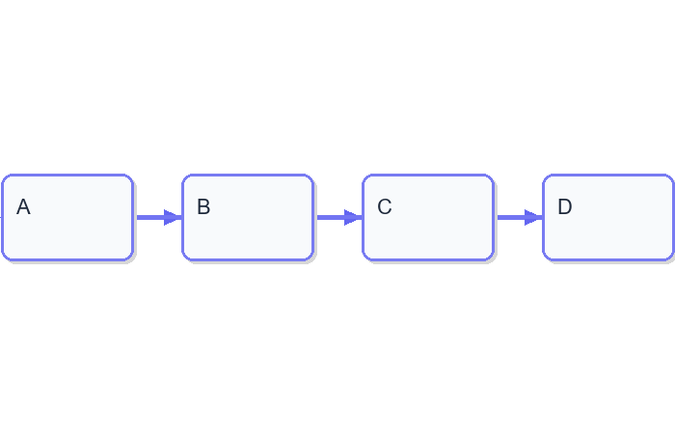
Node.js & Express RESTful API with Middleware: Part
VIT • Node.js & Express RESTful API with Middleware: Part • Slide 5

Slide 6
Creating a GET Route
• Use `app.get()` to define routes
• Pass callback function for response
// Language: NODE.JS + EXPRESS 20.18.0
// Example: Creating a GET Route
var result = computeState();
System.out.println(result);
Expected Output: Output: Verified
VIT • Creating a GET Route • Slide 6

Slide 7
Node.js & Express RESTful API with Middleware: Part
// Language: NODE.JS + EXPRESS 20.18.0
const express = require('express');
const app = express();
app.get('/api/users', (req, res) => res.json({users: ['user1', 'user2'
app.listen(3000, () => console.log('Server running on port 3000'))
Expected Output: Execution verified
VIT • Node.js & Express RESTful API with Middleware: Part • Slide 7

Slide 8
Middleware Function
• Used to modify request or response
• Can be used for logging, validation, etc.
// Language: NODE.JS + EXPRESS 20.18.0
// Example: Middleware Function
var result = computeState();
System.out.println(result);
Expected Output: Output: Verified
VIT • Middleware Function • Slide 8

Slide 9
Node.js & Express RESTful API with Middleware: Part
// Language: NODE.JS + EXPRESS 20.18.0
const express = require('express');
const app = express();
app.use((req, res, next) => {
console.log('Middleware executed');
next();
});
app.get('/', (req, res) => res.send('Hello World!'));
app.listen(3000, () => console.log('Server running on port 3000'))
Expected Output: Execution verified
VIT • Node.js & Express RESTful API with Middleware: Part • Slide 9

Slide 10
Create a GET Route with Middleware
// Language: NODE.JS + EXPRESS 20.18.0
// Example: Create a GET Route with Middleware
var result = computeState();
System.out.println(result);
Expected Output: Output: Verified
VIT • Create a GET Route with Middleware • Slide 10

Slide 11
Routing Middleware
• Handles multiple routes
• Used for common tasks like logging, validation
// Language: NODE.JS + EXPRESS 20.18.0
// Example: Routing Middleware
var result = computeState();
System.out.println(result);
Expected Output: Output: Verified
VIT • Routing Middleware • Slide 11

Slide 12
Node.js & Express RESTful API with Middleware: Part
VIT • Node.js & Express RESTful API with Middleware: Part • Slide 12

Slide 13
Node.js & Express RESTful API with Middleware: Part
VIT • Node.js & Express RESTful API with Middleware: Part • Slide 13

Slide 14
Node.js & Express RESTful API with Middleware: Part
VIT • Node.js & Express RESTful API with Middleware: Part • Slide 14

